Slide 1
Computing Stabilizing Linear Controllers via Policy Iteration for Noisy Systems
Presenter: Zaifu Zhan
Electrical and Computer Engineering
Project Advisor: Prof. Andy Lamperski
12/14/2022

Slide 2

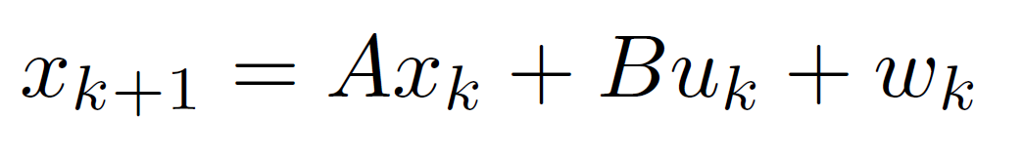
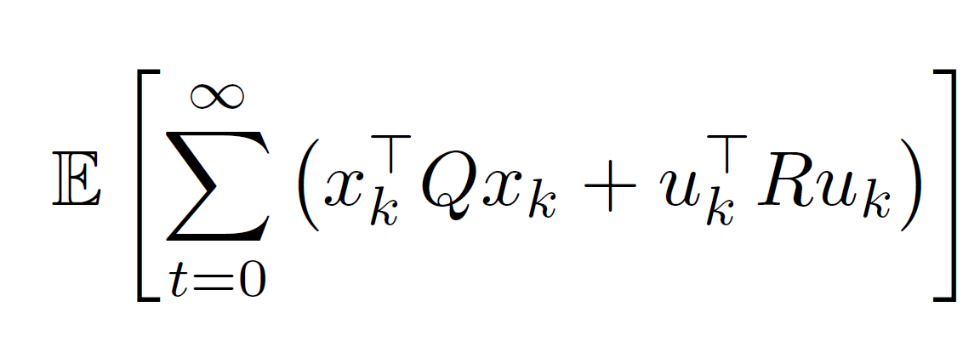
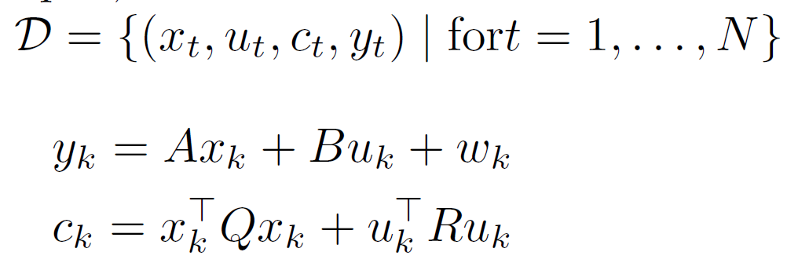
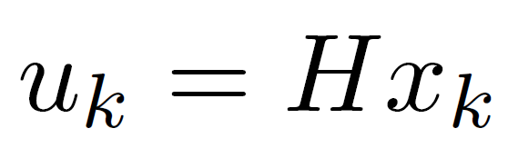
Problem Setup
System model:
Infinite horizon quadratic cost:
Samples
Goal: Find linear state-feedback controller to stabilize the system
Solve ARE

Slide 3
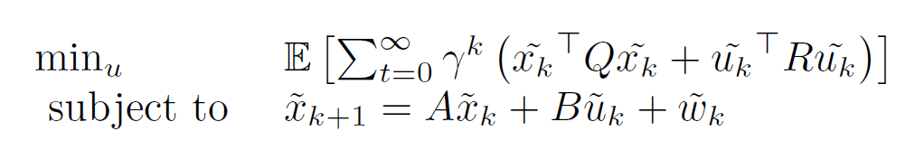
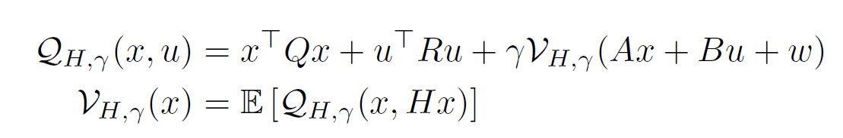
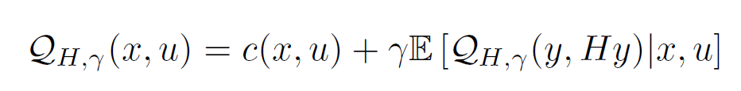
Policy Iteration
Step 1: Initial Policy (H=0) ✔
Do
Step 2: Calculating the action value function
Step 3: Find improve the policy via minimize the function
Until find the best policy

Slide 4

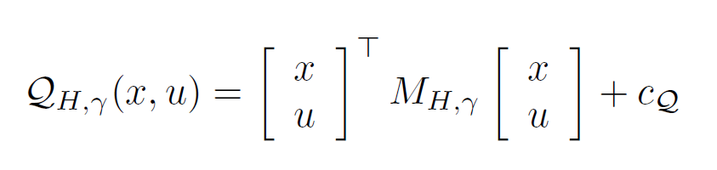
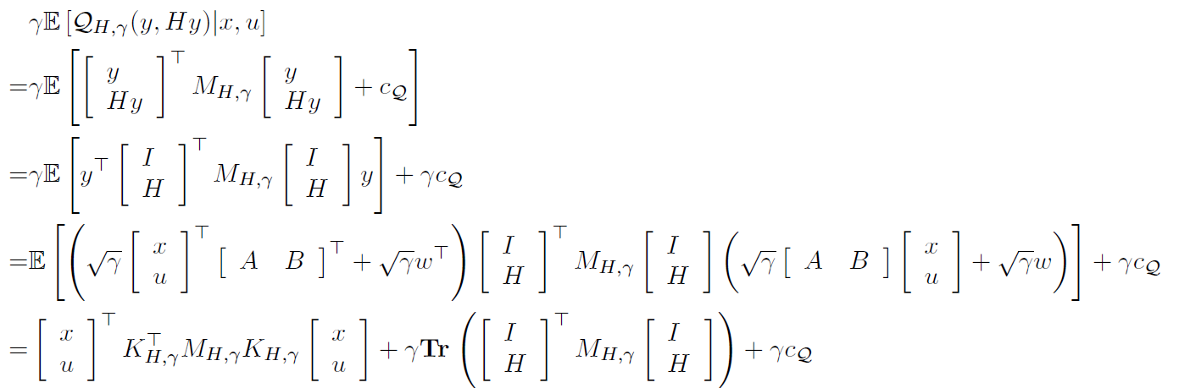
Find Action-Value function
If policy is fixed for LQR
optimization too slow

Slide 5
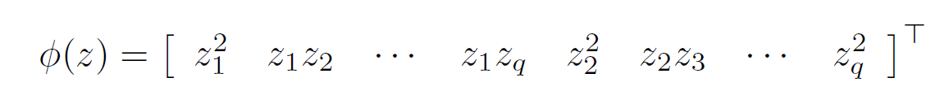
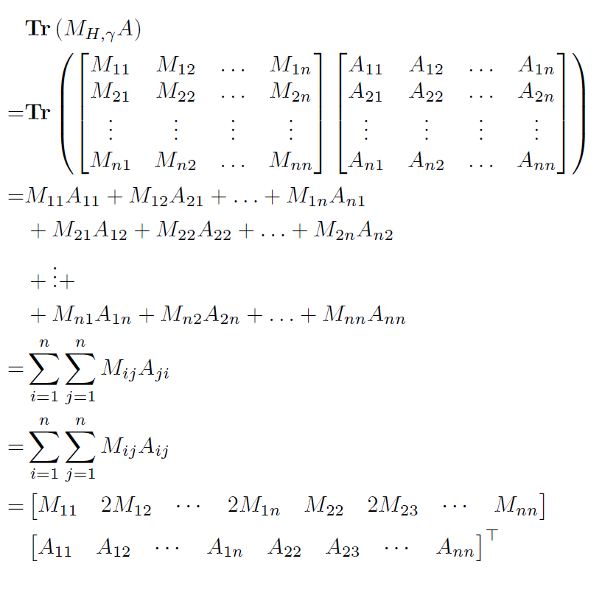
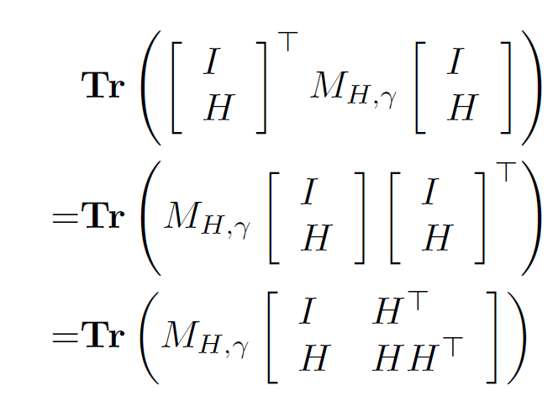
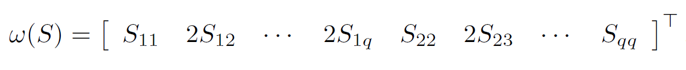
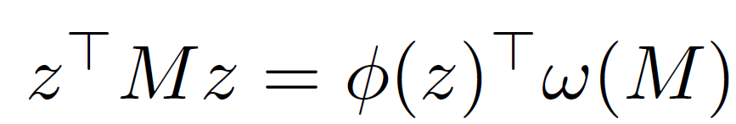
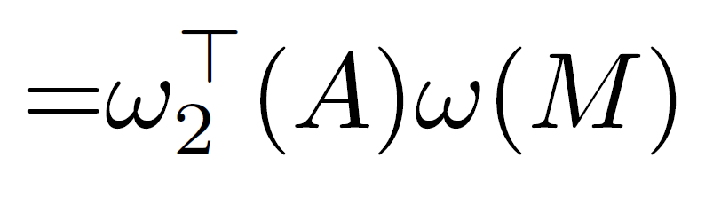
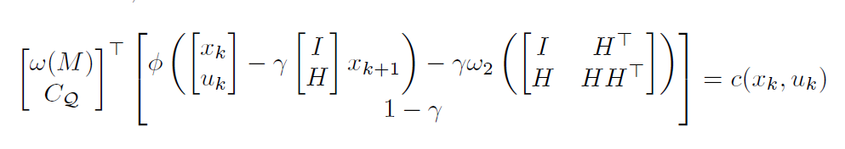
Least square setting
Step 1: Initial Policy✔
Do
Step 2: value function✔
Step 3: Improved policy
Until find the best policy

Slide 6
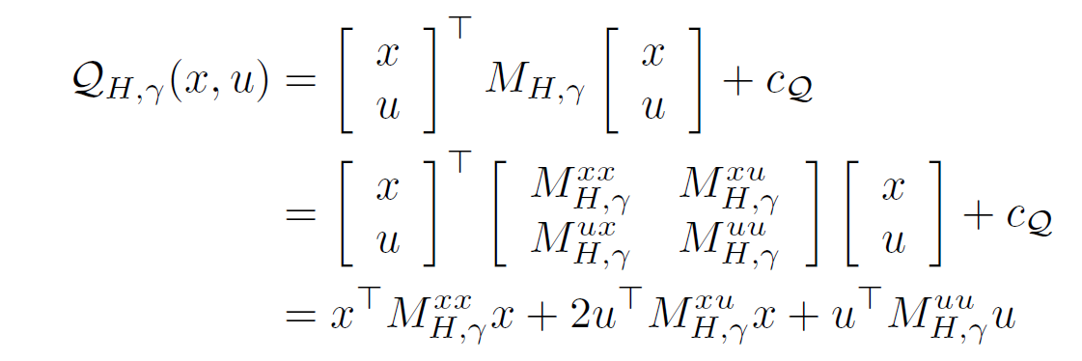
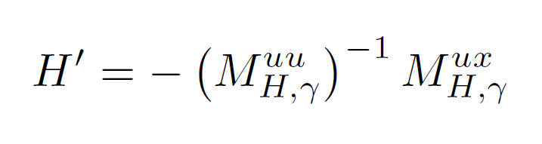
Find improved policy
Take derivative
Step 1: Initial Policy✔
Do
Step 2: value function✔
Step 3: Improved policy✔
Until find the best policy

Slide 7
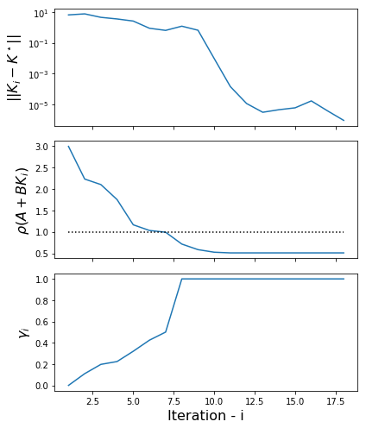
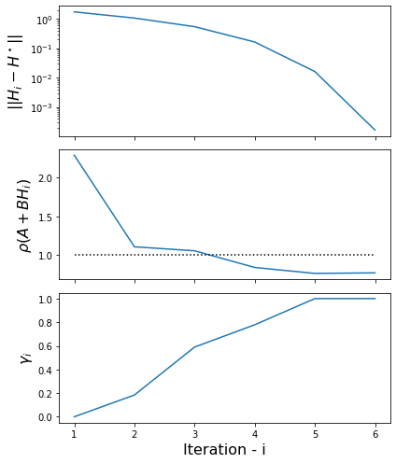
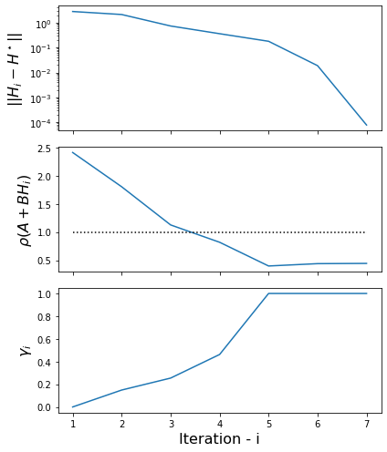
Results: system 5 states & 2 inputs
New Algorithm
[1]
Old Algorithm
Without noise, wrok
With noise，work
Without
noise,
Work
With noise, Fail
[1] A. Lamperski, "Computing Stabilizing Linear Controllers via Policy Iteration," 2020 59th IEEE Conference on Decision and Control (CDC), 2020, pp. 1902-1907

Slide 8
Thank you for listening! Questions?
Presenter: Zaifu Zhan
Electrical and Computer Engineering
Project Advisor: Prof. Andy Lamperski
12/14/2022

